Slide 1
Posturometry The influence of unrecognized left-handedness on posture
©Hanns von Rolbeck, MD
Germany 2020

Slide 2
Background
In order to understand the posture, it is necessary to recognize and understand the cause of incorrect posture due to left-handedness not being lived
A newborn child does not know whether it is right-handed or left-handed
The movement patterns of the educators - as parents, nursery school and school - and the influence of the people around his influence its idea of what is supposed to be right for the child.
The problem now is that the child, unlike his innate movement pattern, gets used to a wrong pattern, which is usually learned in numerous small and large accidents

Slide 3
Ambidextrous?
Attempts in the first half of the 20th century to raise children to symmetrical ambidextrous were discontinued without the desired effect
In people trained on the right, some areas of the movement increasingly shifted to the left hemisphere
The higher-level regions that participate in the planning and control of movements, however, remain in the same place throughout their lives (dominant brain side on the right if you are lefthander)
It is thus possible to (re) activate left-handedness in any phase of life or to live it again
Notes:
Hartwig Siebner, Kiel und Stefan Klöppel Freiburg, Die Studie ist im "Journal of Neuroscience" veröffentlicht

Slide 4
Ambidextrous - more
Brain areas for planning and control showed a preferred activation of their dominant, right hemisphere, in the case of retrained left-handers, despite intensive "retraining"
It was irrelevant whether an activity or work was carried out with the right, the left or with both hands
These right hemispherical areas are even more active in retrained lefties than in lefties who have never been retrained
Notes:
Hartwig Siebner, Kiel und Stefan Klöppel Freiburg, Die Studie ist im "Journal of Neuroscience" veröffentlicht

Slide 5
LEFT handedness - our ancestors

Slide 6
Macaque and left-handed
Foto: HvR.1998

Slide 7
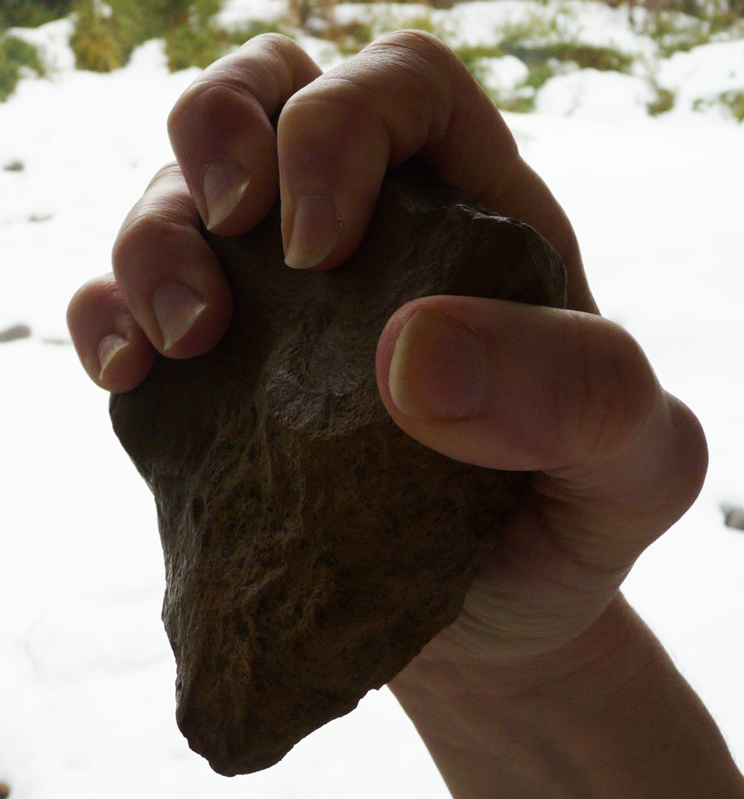
Original handaxes about 1.500.000 years old Lefthand hand ax Right handed hand ax
Foto: HvR.1998
you cannot work with a right-hand ax in your left hand and vice versa

Slide 8
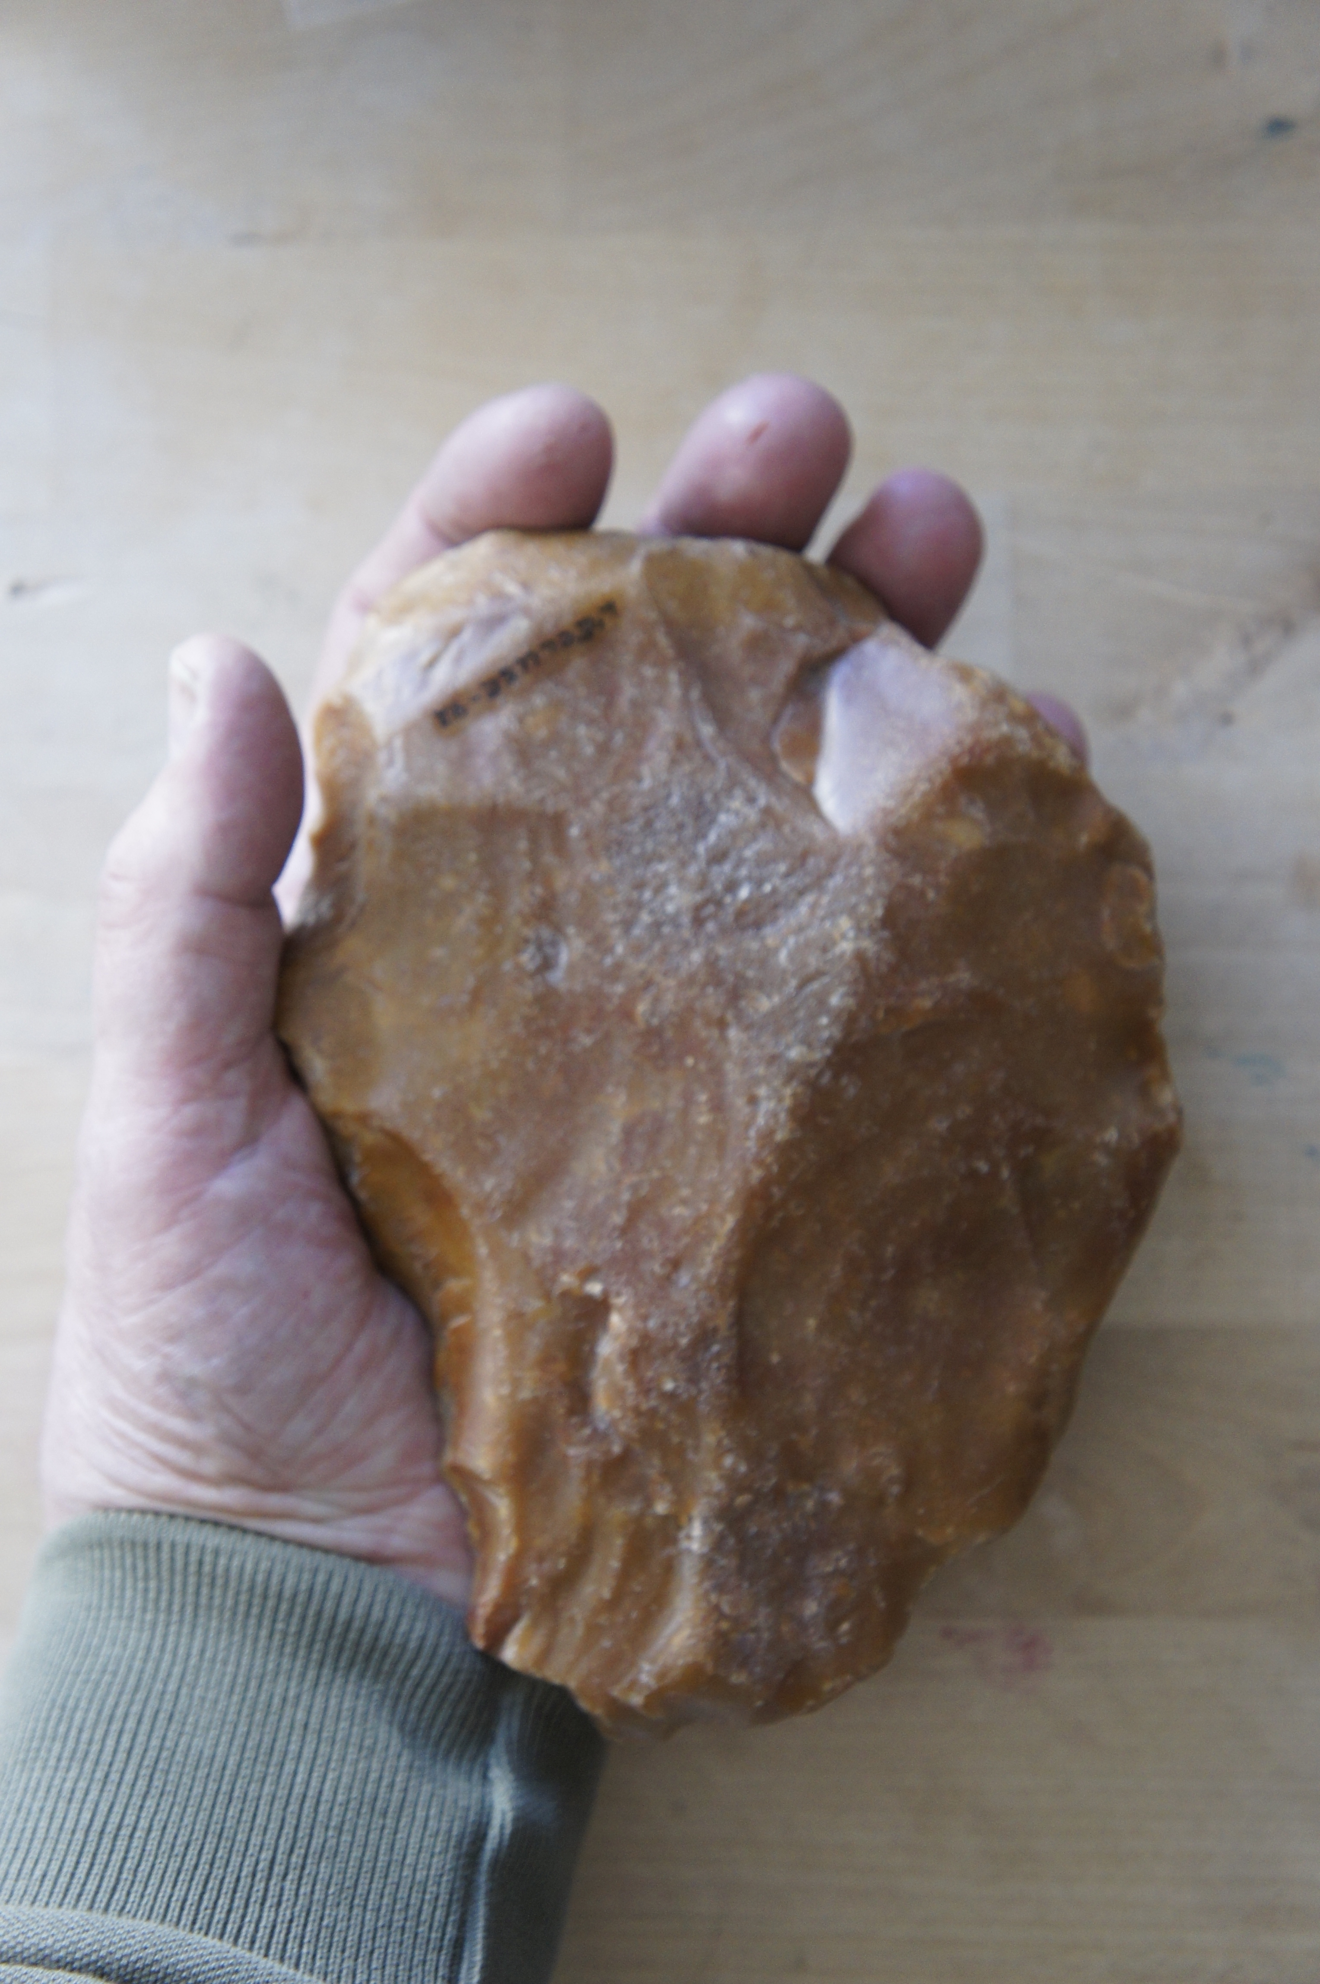
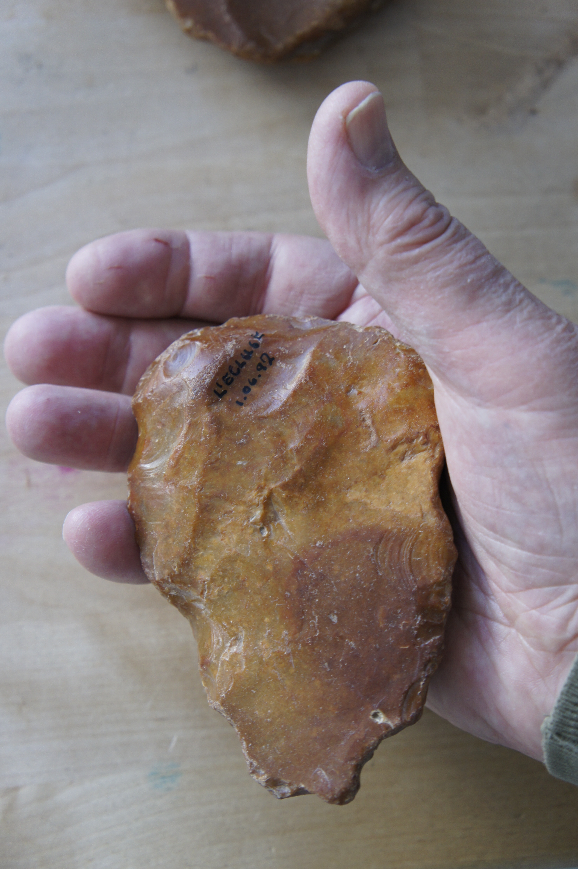
Original Neanderthales handaxes 250.000 years old Lefthand hand ax Right handed hand ax
Foto: HvR.1998
you cannot work with a right-hand ax in your left hand and vice versa

Slide 9
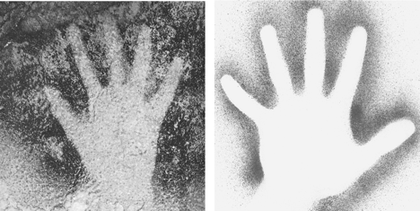
Art or magical handprints 35.000 to 10.000 years Research of C. Faurie and M. Raymond
Rechte Hand (original) Linke Hand (Studenten)
Source: Fauie C. et Raymond. M.: Handedness frequency in the Palaeolithic.
In: Proc. R. Soc. Lond. B (Suppl.) 271, S43-S45 (2004) DOI 10.1098/rsbl.2003.0092

Slide 10
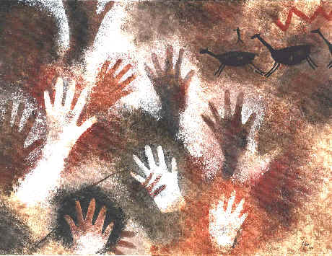
Cueva de las Manos Argentina ca. 9300 Jahre old

Slide 11
LEFT handedness - today

Slide 12
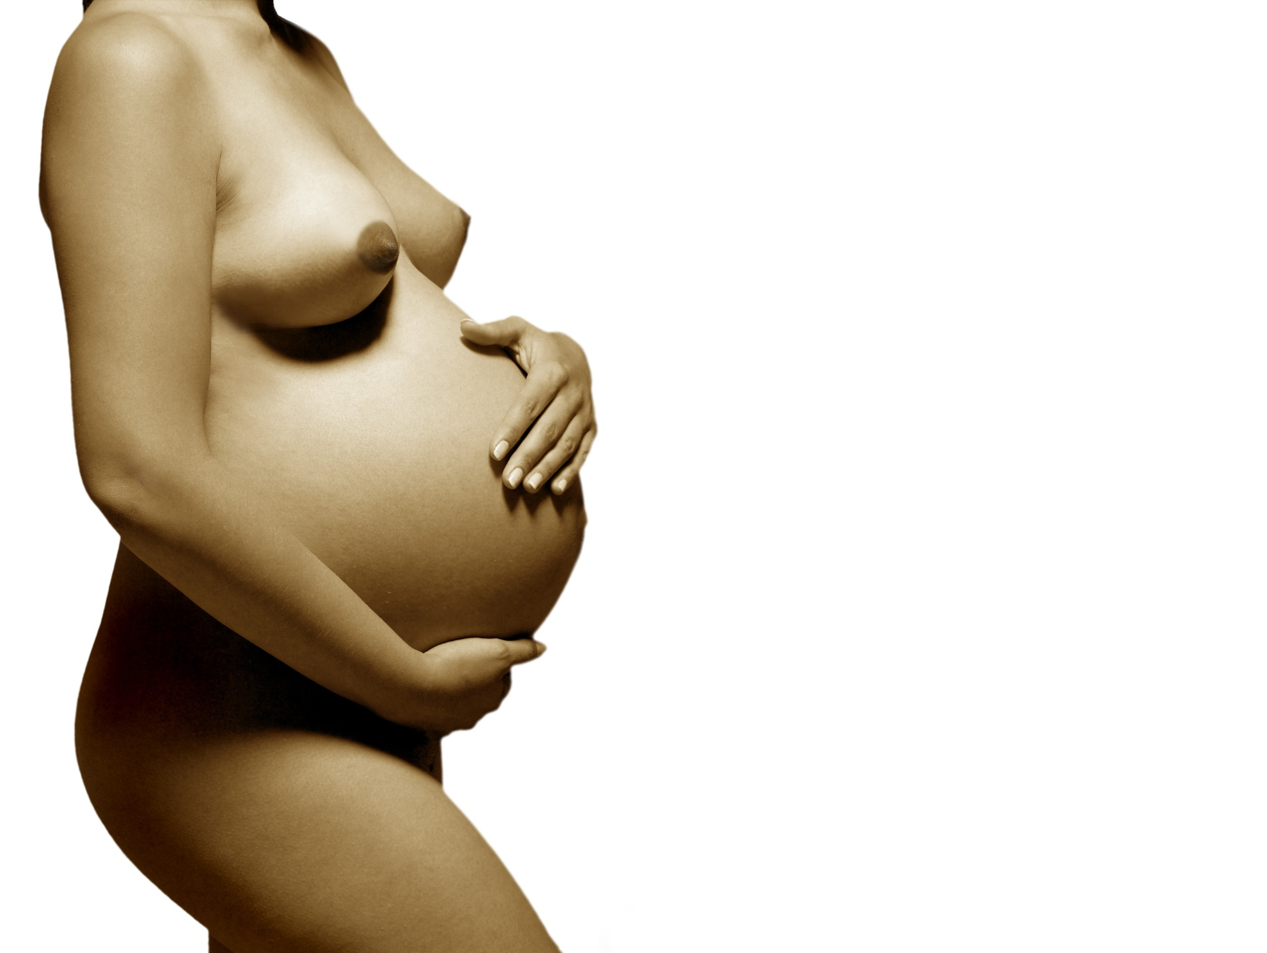
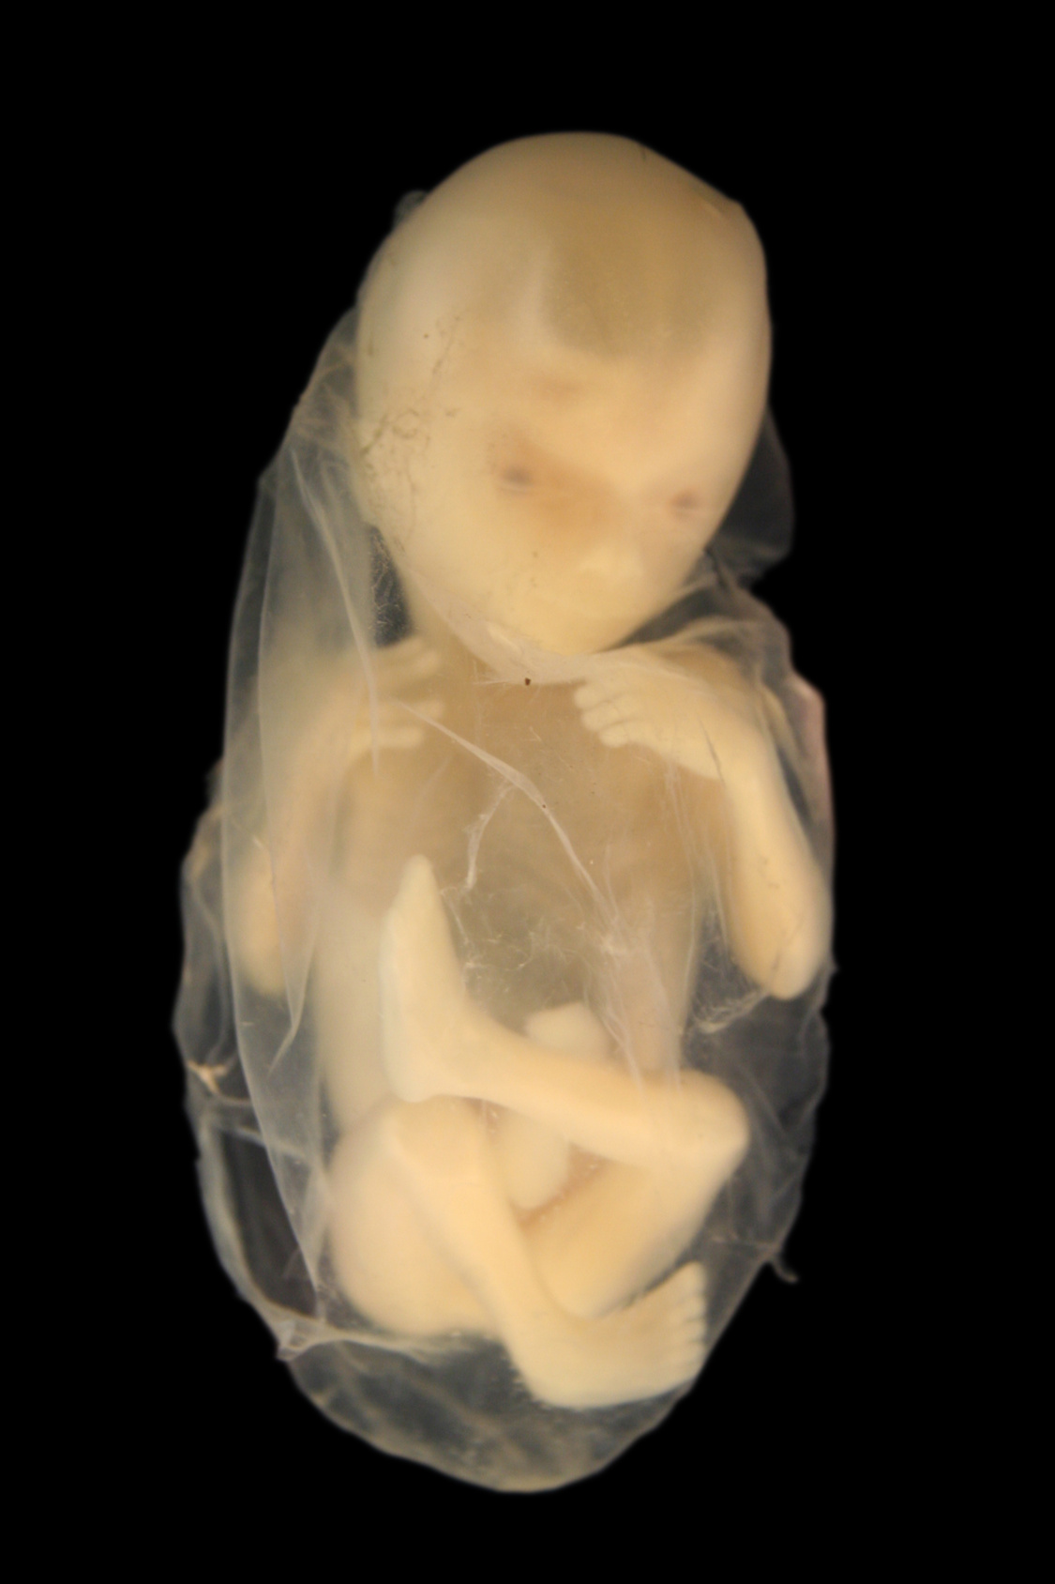
Calms down on the left – holds with right
Source: Fotolia_5512921 Mother Fotolia_3976783 Child

Slide 13
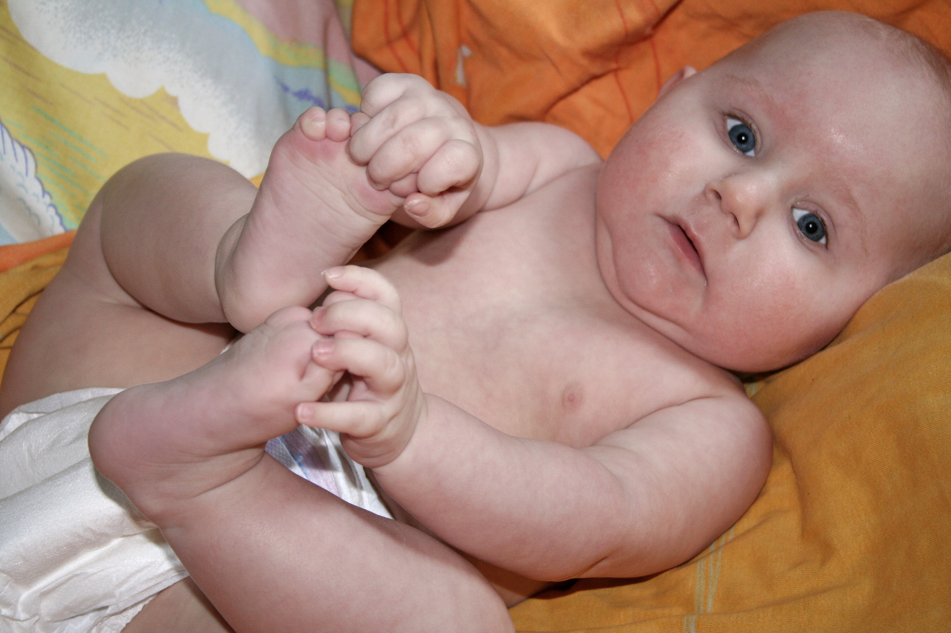
Passive hand: right - Active hand: left

Slide 14
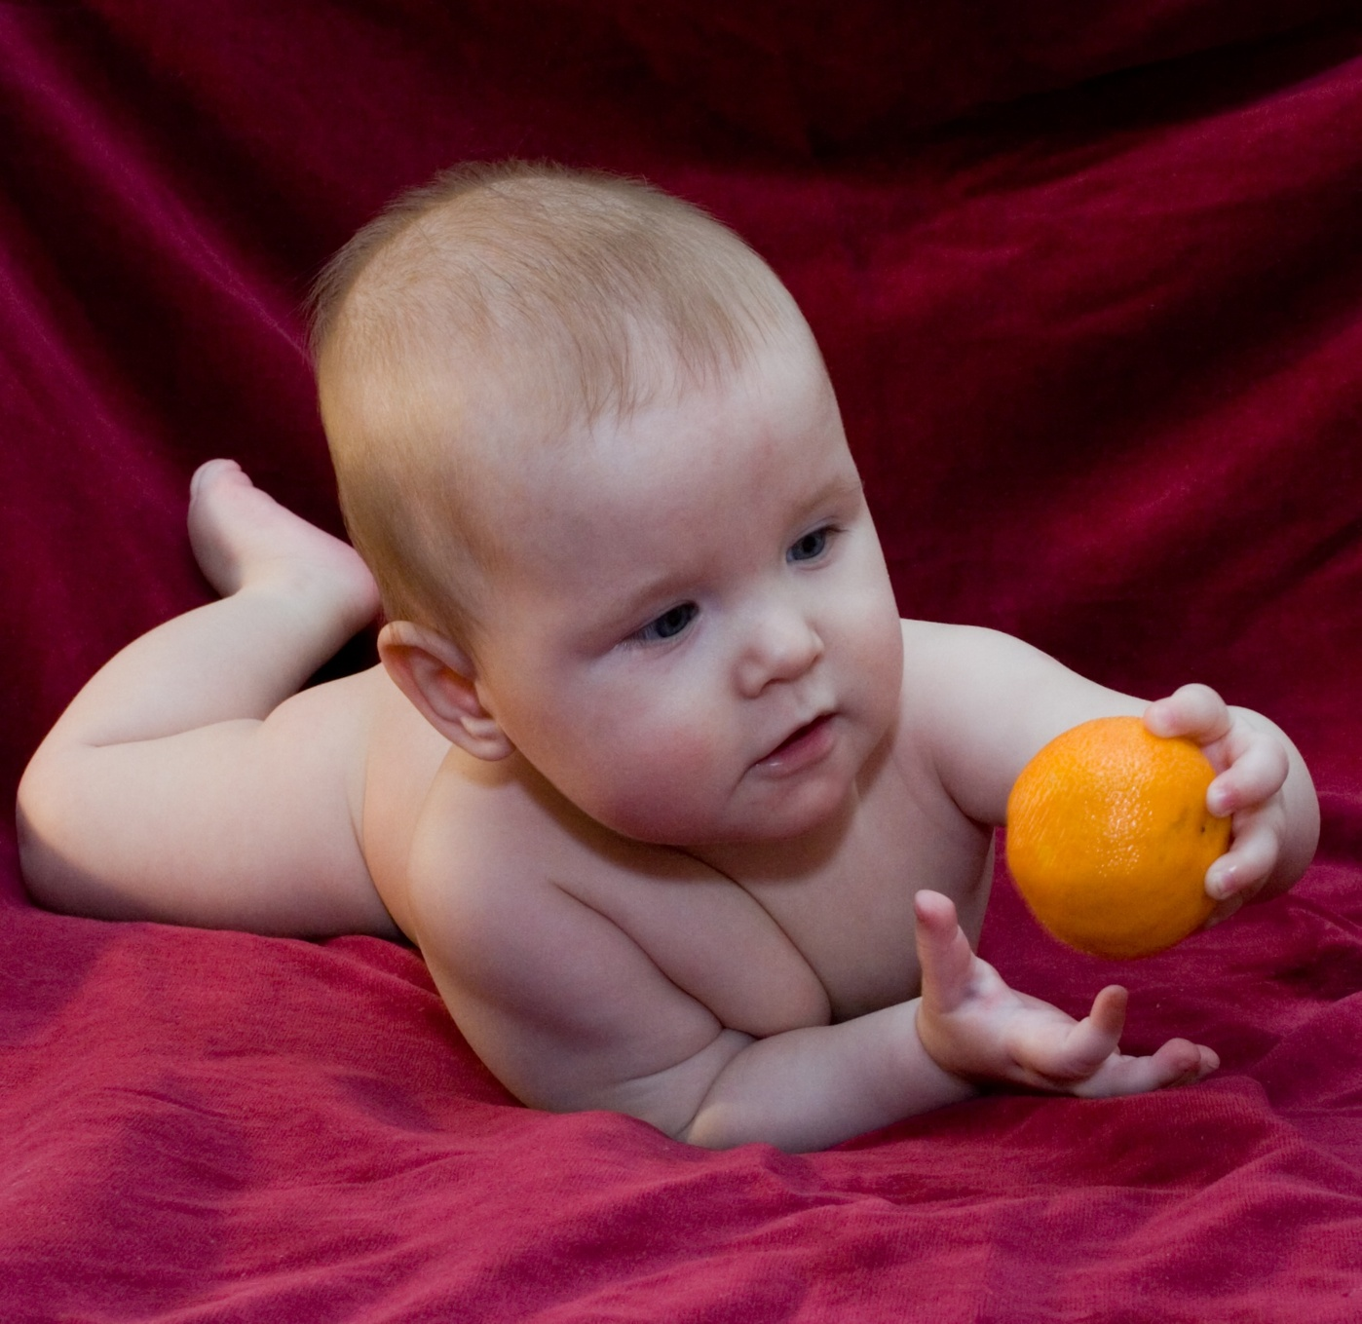
Left is accessed / grasped right stops and holds afterwards
Source: Fotolia_232657
Notes:
Fotolia_232657

Slide 15
Brain-body coordination

Slide 16
Exercises for head-body-eye coordination
The wrong head posture will change the entire spine in the long run
The handedness is paired with the eyes so the eye dominance.
A left-hander has his dominant eye on the left (target eye) and the right-hander has the right eye
If a left-hander mainly works or writes with his right hand, he involuntarily uses to observe the right hand - the right eye - that is usually dominated.
The handedness is paired with the eyes so the eye dominance Source: Helbert S. (2016) Lateralities and Asymmetries of the Orthostatic Posture. mtprehabJournal. 14: 379-389. DOI: http://dx.doi.org/10.17784/mtprehabJournal.2016.'14.379

Slide 17
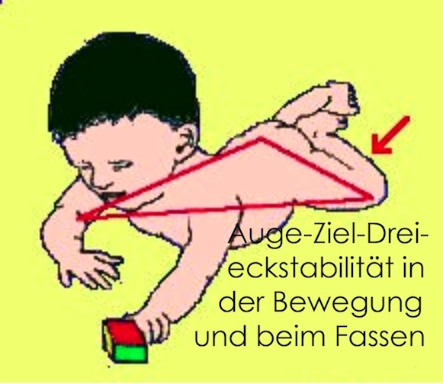
Head posture and the eyes
Basics of learning: triangle stability when practicing and hand-eye coordination
triangle stability is demanded by brain dominance and experienced as safe through the exercises and anchored in the cerebellum
the dominant eye - left-handed the left eye - first records the target and the dominated eye then indicates the distance
this happens already with the toddler and continues until the awakened age

Slide 18
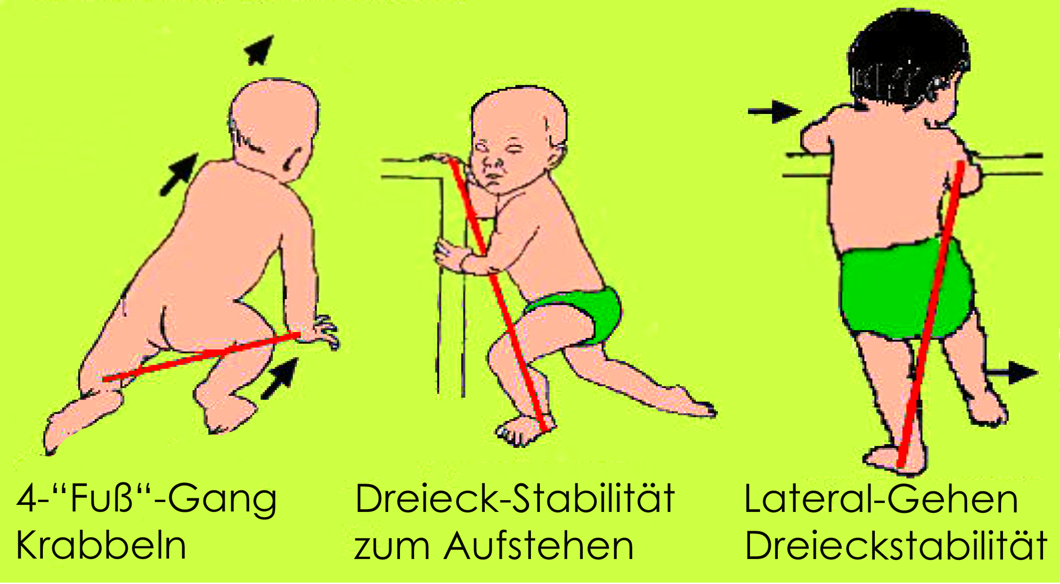
Triangle stability causes the shure body posture

Slide 19
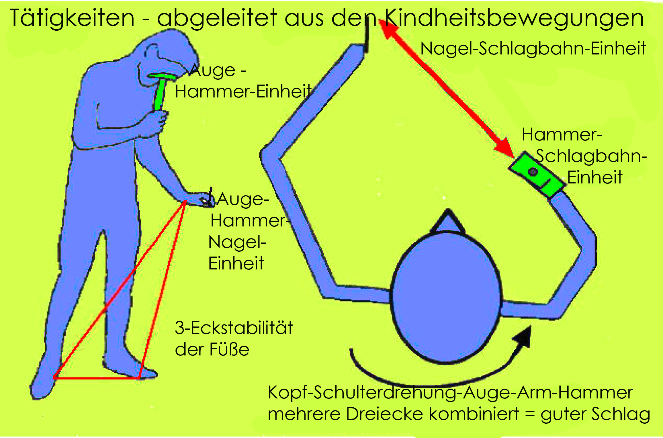
Triangle stability ensures safe work processes

Slide 20
Development of walking
How do learn to walk? Thousands of steps and dozens of falls per day
(Adolph Karen, 2015)

Slide 21
Development of walking
According to the results of Bril¹, there is a greater need for stabilization in children
At the beginning, this apparently enables them to design the COP curve² close to the longitudinal axis of the foot
Body (volume) development, age, foot and body (posture) development have a significant influence on the rolling behavior of the feet when walking
Source: 1- Bril B, Breniere Y: Posture and independent locomotion in early child- hood: Learning to walk or learning dynamic postural control?, in: Savelsbergh G (Hrsg): The development of coordination in infancy. North Holland, Amsterdam,1993, 337-358.
2 -COP: Center of pressure, plantar focus

Slide 22
Head posture and the cervical spine
There are constant influences in the daily routine of school or professional activities on the physiological postural system (sitting for hours at school, unsuitable work place, etc.)
This leads to a new, but now no longer physiological posture and movement pattern adapted to the situation, especially if a wrong handedness is or has to be lived.
In the long run, these situations overwhelm the biological system and local or generalized overloads develop.
The necessary incorrect head posture in particular causes a long-term change in the rotating head joints C0 (skull base) C1 (atlas) and C2 (dens axis)

Slide 23
Head posture and eye coordination

Slide 24
Head posture and spine

Slide 25
Head posture and the spine
The wrong head posture will change the entire spine in the long run

Slide 26
Head posture and Feet

Slide 27
Hands influence posture

Slide 28
Messanlage
Alle Messung erfolgten mit einer Linkshänderin

Slide 29
Rasterography Surface measurement of the trunk and lower extremities

Slide 30
Background of Rasterography
Raster stereography is the optical measurement and analysis of the surface of the back and lower extremities
The biomechanical examination procedure is part of the standard diagnostics established in the department of orthopedics.
It provides a 3-dimensional reconstruction of the back surface, line graphics of the course of the spine and information about the position and angle of the pelvis, legs and feet
Raster stereography is therefore suitable for functional examinations that evaluate the effects of different therapeutic approaches such as proprioceptive or static insoles, bite changes, corrections in the case of ametropia and general posture corrections without radiation.

Slide 31
What is measured
The surface of the back and lower extremities - is captured in high-resolution, three-dimensional light-optical.
Analyzes of the course of the spine in the frontal, sagittal and transverse planes are measured and displayed.
Other biomechanical parameters such as kyphosis / lordosis angle, pelvic / shoulder position, surface rotation, etc. are shown in comparison with reference data.
Typical areas of application are scoliosis, incorrect posture, leg axis asymmetry, craniomandibular dysfunction, accident-related incorrect posture and screening examinations of children and adolescents.

Slide 33
Back mapper system
It is a raster-stereographic surface measurement.
The system achieves unprecedented measurement accuracy through the dynamic superimposition of several stripe images (phase shift process with 24 exposures in 0.5 sec.).
The so-called active triangulation technology precisely captures indifferent surface structures and analyzes them reliably.
BackMapper can be excellently integrated into the existing practice through automated measurement protocols, a computer-controlled height adjustment with patient-specific memory function and its small space requirement (camera-patient distance: only 1.35m).

Slide 34
Software and more
The user-friendly Windows software is installed on a standard computer and is network-compatible due to its modern architecture.
In addition to the classic surface measurement, the BackMapper system offers numerous other medically relevant additions. This includes measuring the cervical spine mobility, carrying out active and passive function tests (Trendelenburg, Matthiass and others), integrating X-rays, pedobarography with heel angle analysis and thermography to localize hyper- and hypothermia.
The different 3D representations can be faded out and, if desired, demonstrated to the patient in "real" 3D resolution.

Slide 35
Dynamic raster stereography with outstanding measurement accuracy (20 x higher than static technology)
Measurement of the back and legs with automated data analysis including all relevant parameters and reference value comparison
Measurement of the lower extremities for the analysis of misalignments of the leg axes
Time required: 5-10 min., Delegable
Small space requirement: only 1.35 m camera-patient distance

Slide 36
Different display options

Slide 37
PedoScan
Pedobarography measuring plate including dongle software for analysis of static and dynamic
Power distribution underfoot
Automatic storage of measurement results and documentation in the BackMapper software
Assessment of foot function, posture and balance
Time required: 1-2 min., Delegable
Simultaneous recording during back measurement

Slide 38
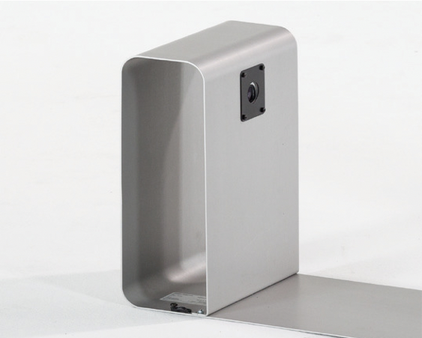
PedoSan Camera and Plate

Slide 39
Presentation of results
Clear printout of all important images and parameters on 1 DinA4 sheet, can be customized with address / logo
Before and after documentation with numerical and graphic comparative representation
Large variety of models for every application (stand, wall and mobile systems, electrically or manually adjustable)
Highest quality standard of hardware and software

Slide 40
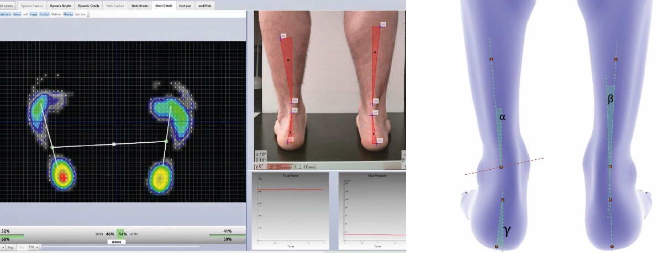
Kamera zur Bestimmung der Fersenwinkel (PedoCam) > Software zur Auswertung und Einbindung in die BackMapper-
> Zeitbedarf: 2-3 min., delegierbar

Slide 41
Example of measurement

Slide 42
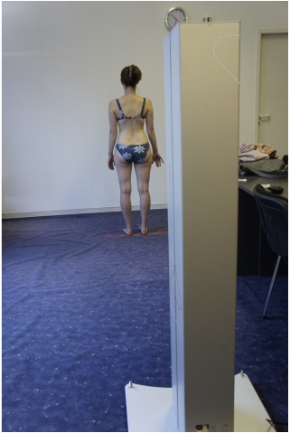
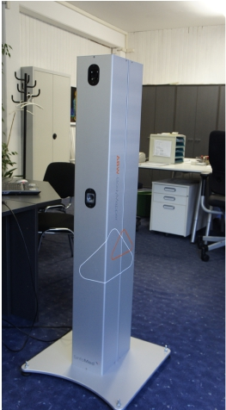
Messanlage
Alle Messung erfolgten mit einer Linkshänderin

Slide 43
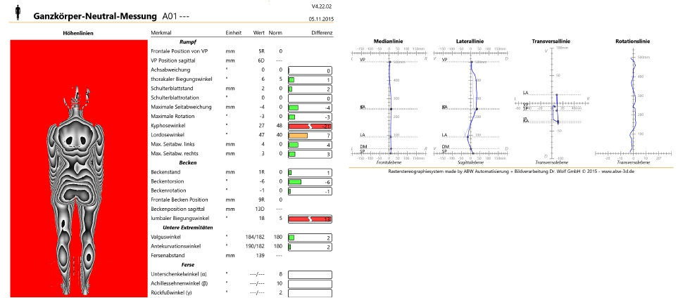
Ganzkörperscan: Messprotokoll

Slide 44
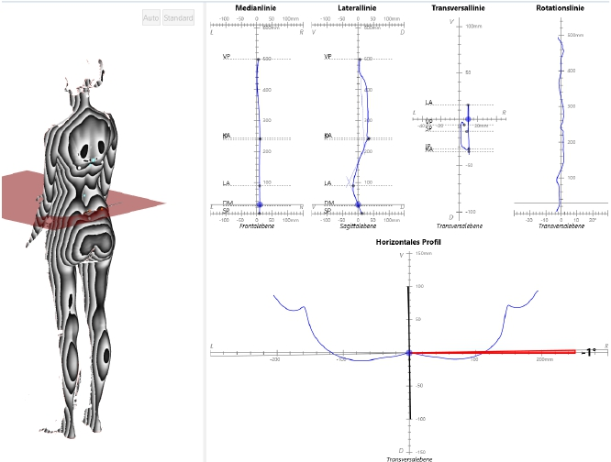
Segmentales Messprotokoll

Slide 45
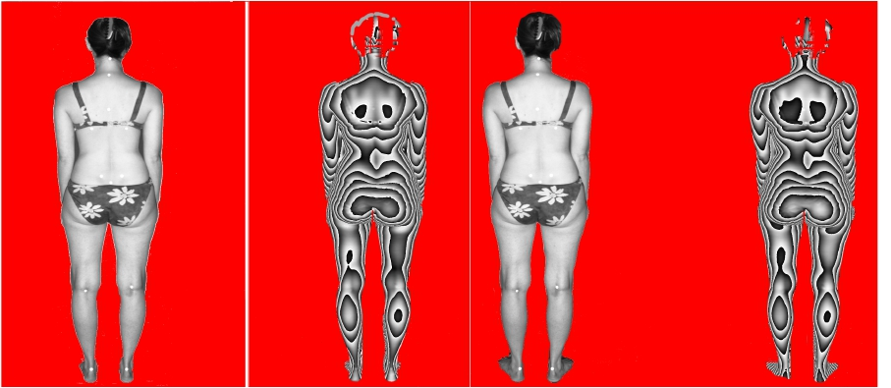
Messung Ausganggssituation
Füße parallel – ohne Stimulation – Füße 7 Grad

Slide 46
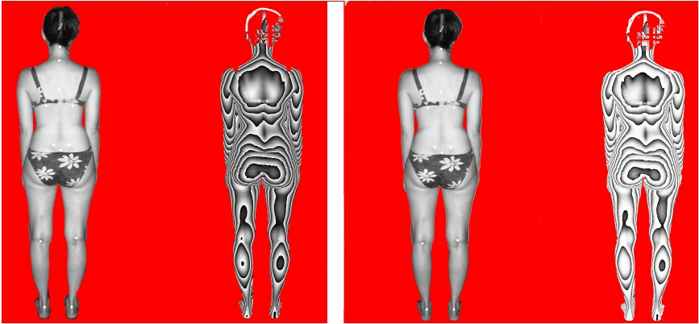
Neutralstellung – Füße parallel
Spitzer links
Spitzer rechts

Slide 47
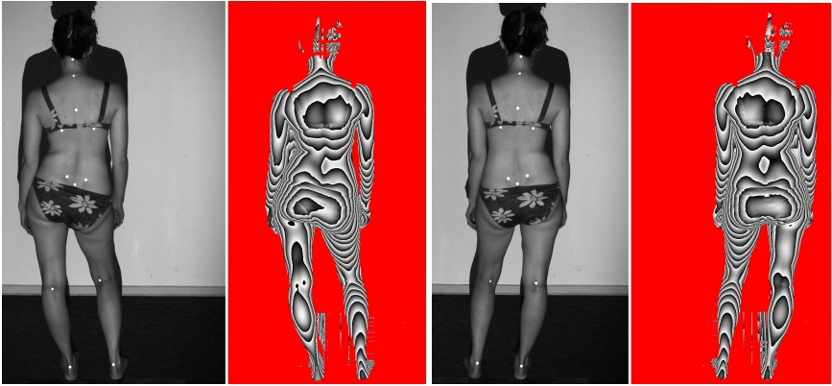
Standbein
links
rechts (WS gerader)

Slide 48
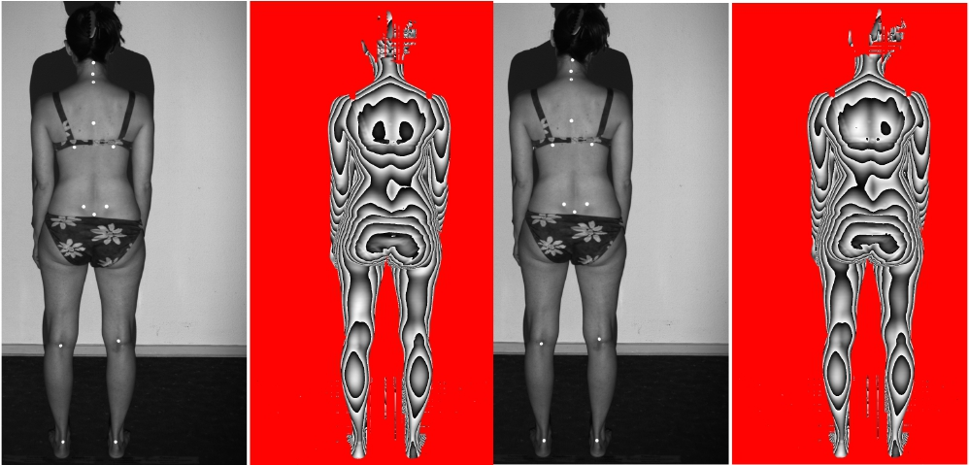
Leitauge (sehen mit einem Auge)
links rechts

Slide 49
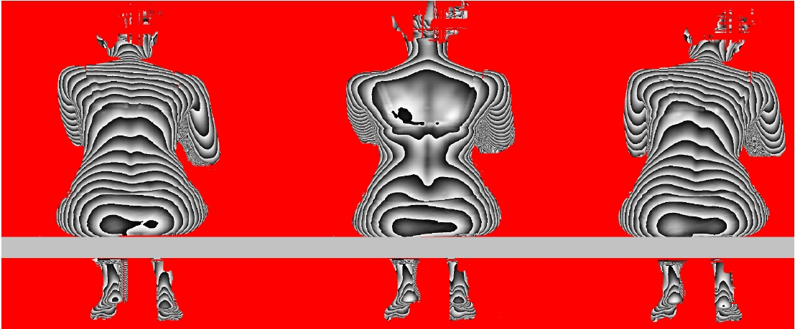
Sitzen
links schreiben
Neutralposition
rechts schreiben

Slide 50
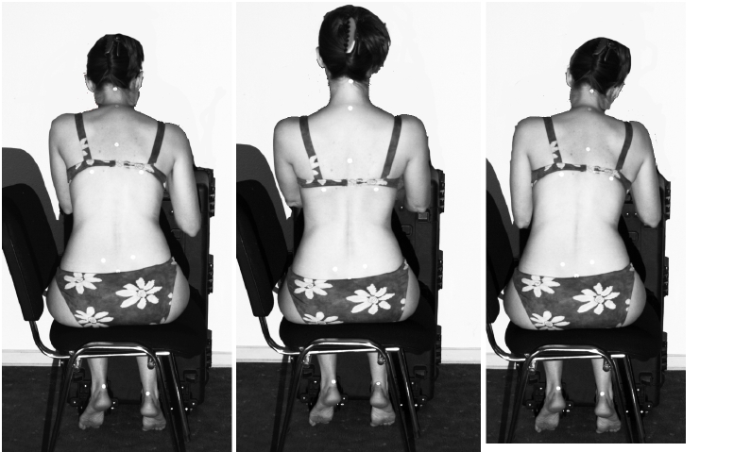
Sitzposition
schreibt links
ohne Stift
schreibt rechts

